Slide 1
CAD System
Classical approach
Tewodros Arega, Abdullah Thabit

Slide 2
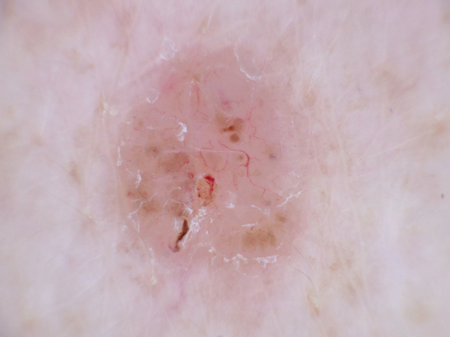
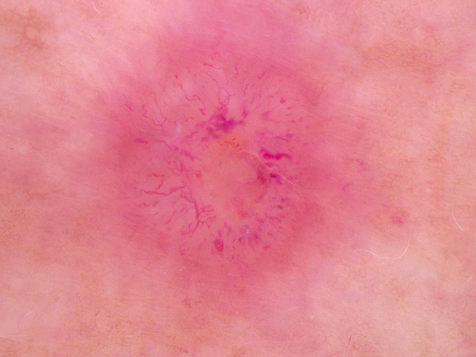
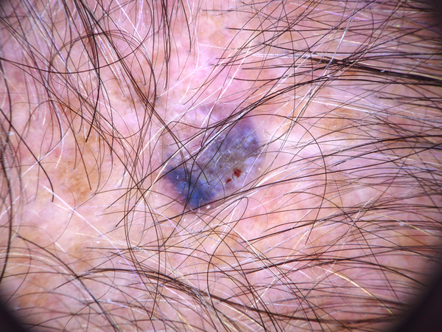
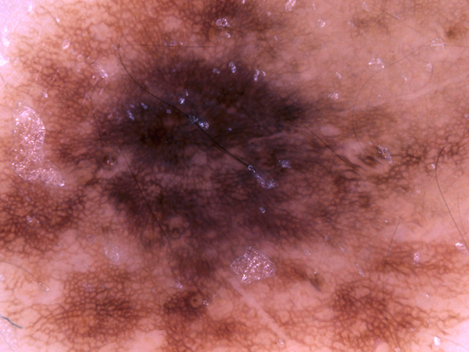




Project Objectives
Build a CAD system to address two main problems:
Skin Lesion Classification
6000 images (half benign and half other classes)
Histopathology Classification
29494 images (half benign and half malignant)

Slide 3
Table of contents
CAD system Framework
Design and Implementation
Results and analysis

Slide 4
CAD System Framework
Feature Extraction
Classification
Pre-processing
Data Preparation
Benign
Malignant

Slide 5
Design and Implementation
Data Preparation
Preprocessing
Feature Extraction
Classification
Train/Test split
1st approach: split data into Training and validation sets
2nd approach: Perform 5-fold cross validation
ROI
Whole Image (full size/resized)
Spatial windowing
Lesion Area (masked/un-masked)

Slide 6
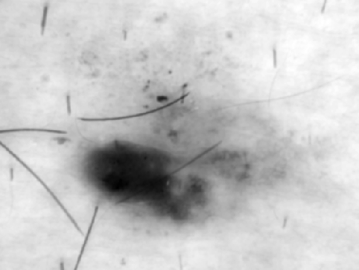
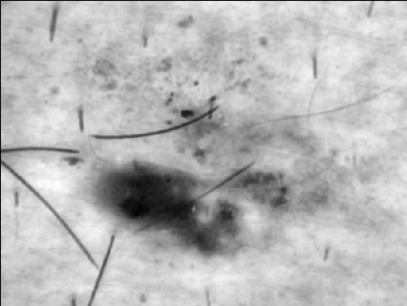
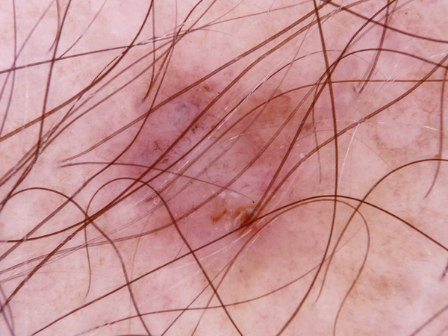
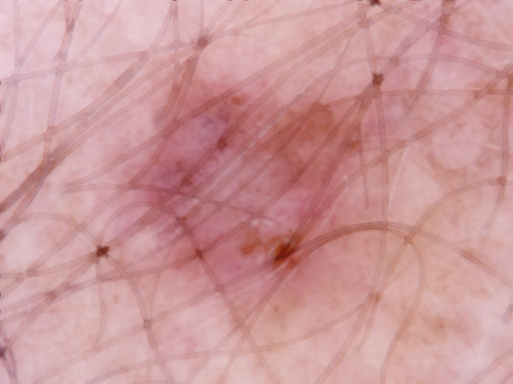
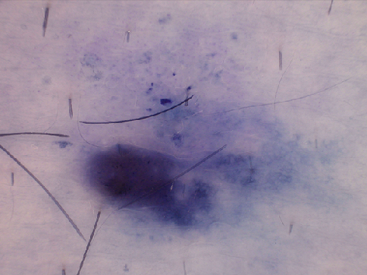
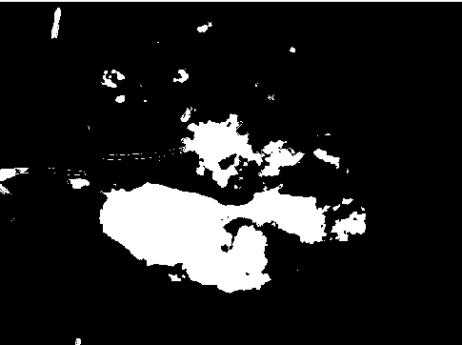
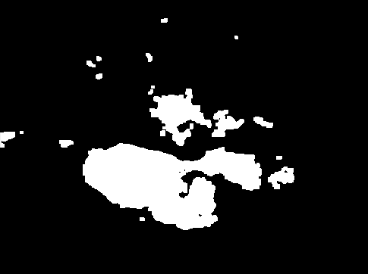
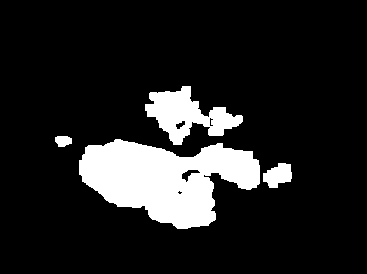
Design and Implementation
Data Preparation
Preprocessing
Feature Extraction
Classification
Color Spaces
RGB, HSV, LAB, YCrCb
Contrast Enhancement
CLAHE
Hair Removal
Inpaint with morphology
Lesion ROI segmentation
Thresholding, Watershed and
Ellipse masking

Slide 7
Design and Implementation
Data Preparation
Preprocessing
Feature Extraction
Classification
Color Statistics (Nx48)
Mean, Standard Deviation, Skewness and Kurtosis
Color Histogram (Nx64)
Shape features (Nx7)(Nx25)
Humoments, Zernike moments
Texture features (Nx10)(Nx13)(Nx120)
Local Binary Pattern, haralick (GLCM), Gabor Filters
Gradient features
HOG
Local Features(Nx256)(Nx4096)
BOW representation

Slide 8
Design and Implementation
Data Preparation
Preprocessing
Feature Extraction
Classification
Linear SVM
SVM
Bagging Classifier(decision trees)
Random Forest

Slide 9
Results and Analysis (Skin)
Whole Image
Spatial Windowing
Lesion Area
Lesion Area (masked)
Other Color Spaces
Contrast Enhancement
Hair Removal
Segmentation
Color Statistics
Color Histogram
LBP
GLCM
Hu-moments
Zernike moments
BOW
Gabor filters
LinearSVM
SVM
Random Forest
Bagging Classifier
Our first and simplest model
Extracted mean and standard deviation from each of the image RGB channels
Achieved 75% accuracy on the validation set

Slide 10
Results and Analysis (Skin)
Whole Image
Spatial Windowing
Lesion Area
Lesion Area (masked)
Other Color Spaces
Contrast Enhancement
Hair Removal
Segmentation
Color Statistics
Color Histogram
LBP
GLCM
Hu-moments
Zernike moments
BOW
Gabor filters
LinearSVM
SVM
Random Forest
Bagging Classifier
Adding color information from other color spaces like (HSV, LAB, YCrCb)
Using Skewness and kurtosis features from each channel
Using Random Forest instead of Linear SVM
Include Texture features
Improved accuracy to 83%

Slide 11
Results and Analysis (Skin)
Whole Image
Spatial Windowing
Lesion Area
Lesion Area (masked)
Other Color Spaces
Contrast Enhancement
Hair Removal
Segmentation
Color Statistics
Color Histogram
LBP
GLCM
Hu-moments
Zernike moments
BOW
Gabor filters
LinearSVM
SVM
Random Forest
Bagging Classifier
Removed Color Histogram from the features matrix
Applied mean and standard deviation normalization on the features
Switched to an SVM classifier with an RBF kernel
Accuracy jumped to 86.5%

Slide 12
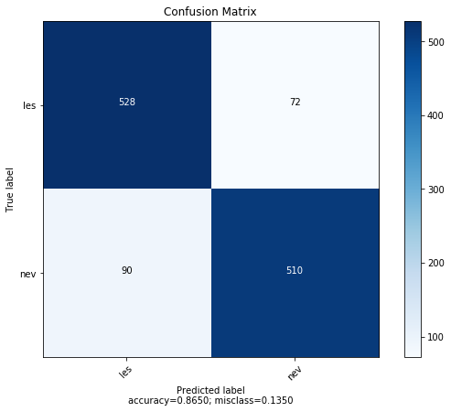
Results and Analysis (Skin)
BEST performing model (on validation set)

Slide 13
Results and Analysis (Skin)
Whole Image
Spatial Windowing
Lesion Area
Lesion Area (masked)
Other Color Spaces
Contrast Enhancement
Hair Removal
Segmentation
Color Statistics
Color Histogram
LBP
GLCM
Hu-moments
Zernike moments
BOW
Gabor filters
LinearSVM
SVM
Random Forest
Bagging Classifier
Using Segmentation to extract shape features and other color and texture features only from the lesion area
Shape features did not perform well
No noticeable improvement on the accuracy (excluding shape features)

Slide 14
Results and Analysis (Skin)
Whole Image
Spatial Windowing
Lesion Area
Lesion Area (masked)
Other Color Spaces
Contrast Enhancement
Hair Removal
Segmentation
Color Statistics
Color Histogram
LBP
GLCM
Hu-moments
Zernike moments
BOW
Gabor filters
LinearSVM
SVM
Random Forest
Bagging Classifier
Tested Bag of Words (BOW) with different number of words (64, 128, 256, 512)
Tried different key points detectors (DENSE, SIFT, GFTT) and descriptors (SIFT, rootSIFT, SURF)
Best result with BOVW (256 words, DENSE and rootSIFT) couldn’t go beyond 73% with LinearSVM as a classifier

